Slide 1
RAINFALL PREDICTION
PRESENTED BY
M.SRIVIBHA

Slide 2
ABSTRACT
Rainfall Prediction is to predict the amount of rainfall over a region. It is important to exactly determine the rainfall effective use of water resources, crop productivity and pre-planning of water structures.
In this project we use Machine learning technique i.e, Linear Regression is a process of learning a specific task without any human intervention , this tells us how many inches of rainfall can expect.

Slide 3
INTRODUCTION
“Rainfall Prediction” is helpful to avoid flood which save lives and properties of humans. Moreover, it helps in managing resources of water. Information of rainfall in prior helps farmers to manage their crops better which result in growth of country’s economy. Fluctuation in rainfall timing and its quantity makes rainfall prediction a challenging task for meteorological scientists.
Rainfall predictions are made by collecting quantitative data about the current state of the atmosphere. Accurate prediction of rainfall is a difficult task due to the dynamic nature of the atmosphere.

Slide 4
LITERATURE SURVEY
Prediction of all India summer monsoon rainfall using Error-Back propagation Neural Network.
All India summer monsoon rainfall prediction using an Artificial Neural Network.
Modeling and prediction of rainfall using Artificial Neural Network and ARIMA techniques.

Slide 5
SYSTEM ANALYSIS
Existing system :If we observe the previous existing projects of rainfall predictions they had considered the data-sets which belongs to the average rainfall of months based on year-wise data. They had predicted the average rainfall of upcoming months and they faced few errors like RMSE , MSE and correlation coefficient.
Proposed system :In this project by considering the Austin weather dataset, predicted average rainfall based on the climatic parameters like Humidity, DewPoint , SeaLevelPressure , Visibility Miles and Precipitation Inches. Using Linear Regression can predict average Rainfall with more accuracy compared to other algorithms.

Slide 6
REQUIREMENTS
SOFTWARE REQUIREMENTS:
Operating System: Windows 7 or above
Coding Language:Python
Libraries: Numpy, pandas, scikit-learn
Software : Anaconda

Slide 7
SYSTEM MODULES
Data Collection
Data Preprocessing
Choose a Model
Training and Testing the model on data
Evaluation
Predictions

Slide 8
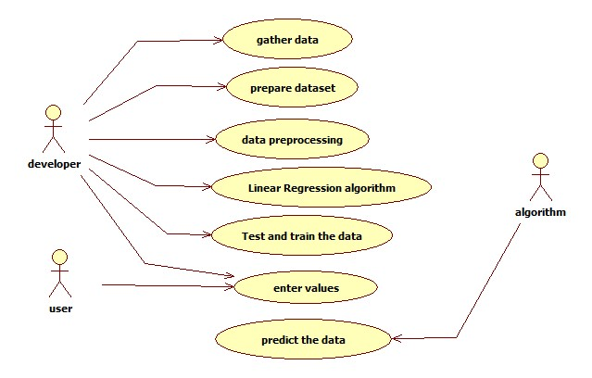
SYSTEM DESIGN
UML DIAGRAMS :
1.Use case Diagram :

Slide 9
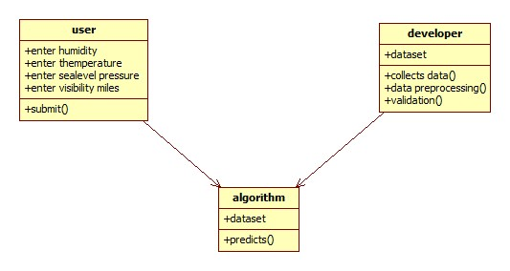
2.Class Diagram

Slide 10
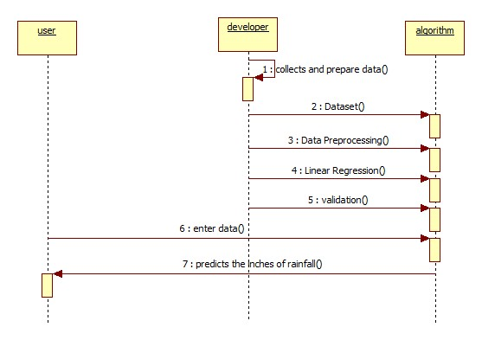
3.Sequence Digram

Slide 11
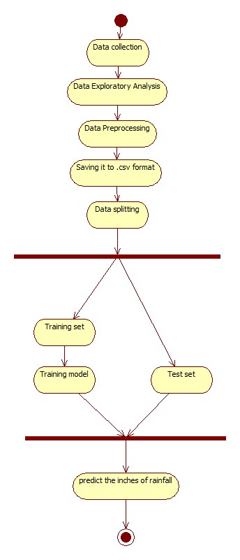
4.Activity Diagram

Slide 12
IMPLEMENTATION
p-value
import statsmodels.api as sm
model=sm.OLS(y,x).fit()
model.summary()
The value which is p<0.0.5 i.e with high p-value corresponding data field has to be deleted if the deleted field made the R-Square and adjusted R-square decrease then that is the wrong choice, if R-Square and adjusted R-square increase then it is the right choice.

Slide 13
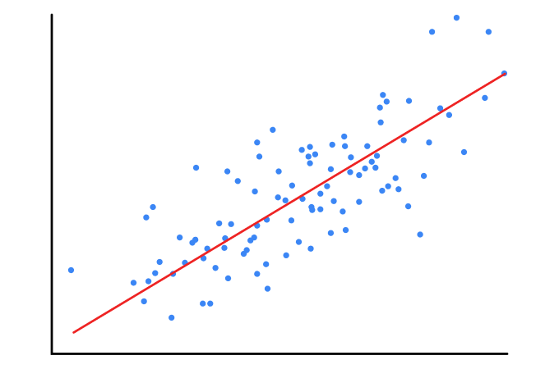
Linear Regression :Linear Regression is a machine learning algorithm based on supervised learning. It performs a regression task. Regression models a target prediction value based on independent variables.
from sklearn.linear_model import LinearRegression
regressor = LinearRegression()
regressor.fit(x_train,y_train)

Slide 14
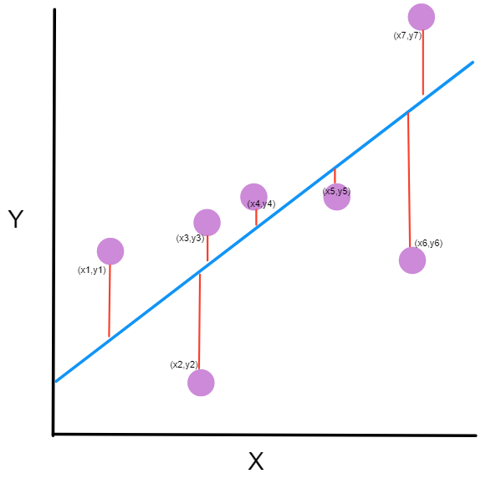
Mean Square Error: The mean squared error tells you how close a regression line is to a set of points. It does this by taking the distances from the points to the regression line these distances are the “errors” and squaring them.,It's called the mean squared error.
from sklearn.metrics import mean_squared_error
y_predict=regressor.predict(x_test)
accuracy=mean_squared_error(y_test,y_predict)
print(accuracy)

Slide 15
Root Mean Square Error: RMSE is a measure of how spread out these residuals are. In other words, it tells you how concentrated the data is around the line of best fit. The square root of the Mean Square Error is Root Mean Sqaure
from sklearn import metrics
y_pred = regressor.predict(x_test)
print('Root Mean Squared Error:', np.sqrt(metrics.mean_squared_error(y_test, y_predict)))

Slide 16
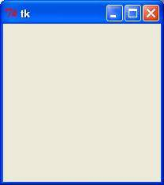
Tkinter: Tkinter is the standard GUI library for Python. Python when combined with Tkinter provides a fast and easy way to create GUI applications. Tkinter provides a powerful object-oriented interface to the Tk GUI toolkit.
import Tkinter
top = Tkinter.Tk()
# Code to add widgets will go here...
top.mainloop()

Slide 17
TESTING
Generally testing can be done either manually or automatically. In RAINFALL PREDICTION Manual testing is done. During testing, validation of this application is done, and it is checked for any defects or errors. If the project contains any error in it, it generates wrong output. To avoid this, manual testing is done.
Machine Learning models would also need to be tested as conventional software development from the quality assurance perspective. Techniques such as blackbox and white box testing.Machine Learning represents a class of software that learns from a given set of data and then makes predictions on the new data set based on its learning.

Slide 18
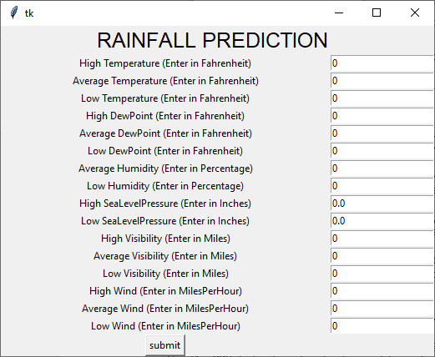
SCREENS SCREEN 1
Here the default value is 0.0 which appears before the user enter.

Slide 19
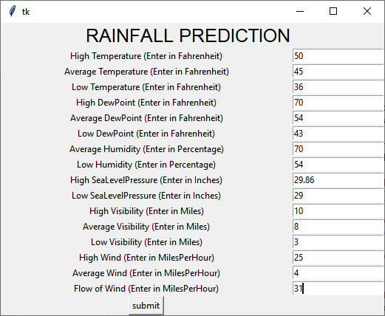
SCREEN 2
This is the screen where user has entered the values.

Slide 20
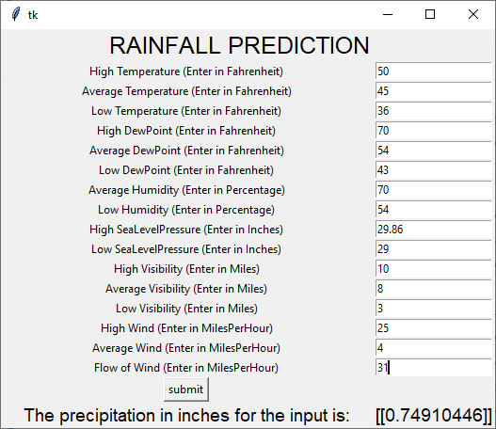
SCREEN 3
This is the screen appears after submitting the values and the output is displayed below the submit button i.e average rainfall predicted.

Slide 21
CONCLUSION
The estimation of rainfall is of great importance in terms of water resources management, human life and their environment. It can be met with the incorrect or incomplete estimation problems because rainfall estimation is affected from the geographical and regional changes and properties.

Slide 22
THANK YOU

